Slide 1
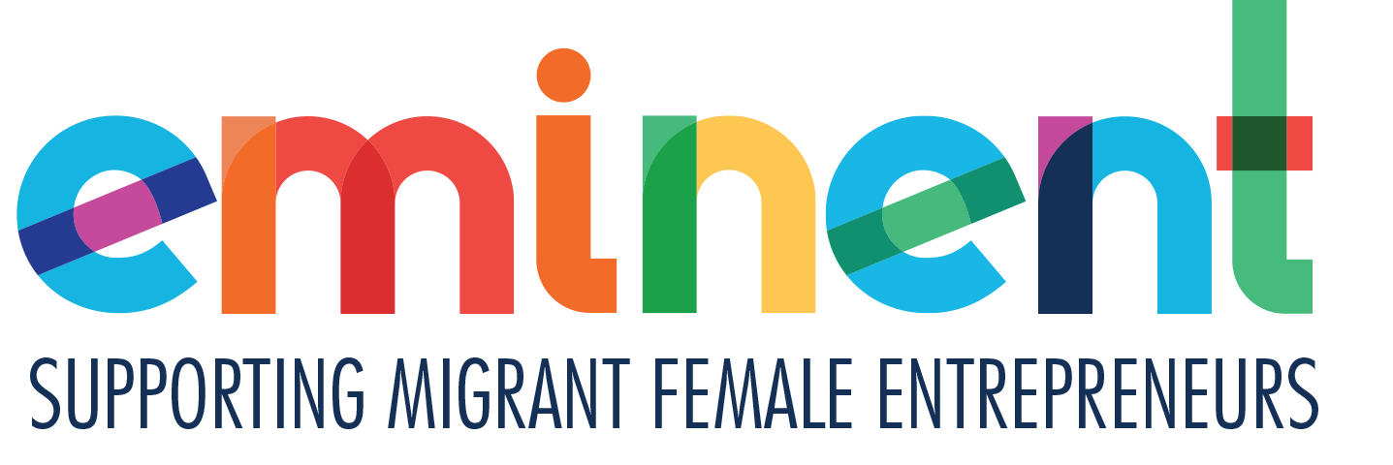
STEP 4
FINANCES AND FUNDING YOUR START UP
LET'S GET PRACTICAL
Managing & raising project finance to start your business
This programme has been funded with support from the European Commission
This project has been funded with support from the European Commission. This publication [communication] reflects the views only of the author, and the Commission cannot be held responsible for any use, which may be made of the information contained therein.

Slide 2
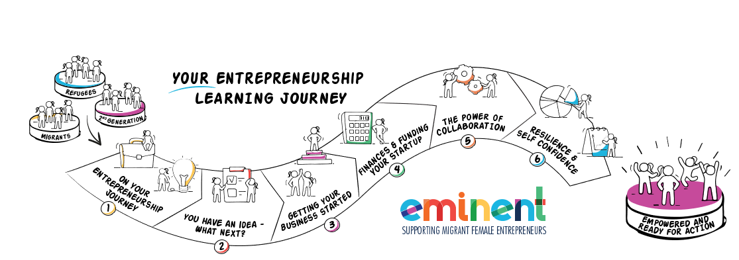
EMIMENT wants to enable Female Migrant Entrepreneurs. We want to bring you on your learning journey to gain the knowledge and skills you need to gain the confidence to establish and successfully run your own business.
Can you? Of course, you can. Open your mind and let us bring you on Your Entrepreneurial Learning Journey…….

Slide 3
IN STEP FOUR, YOU WILL LEARN
PAGES
Is your business viable ? Costing, pricing and breakeven 3- 18
What financial resources do you need to start up ? 19-28
Where can you find support? 29- 30
For low start-up investments 31- 49
More complex start-up investments 50- 68
Overcoming a ‘NO’ when seeking funding 69- 73
Starting a business represents a significant opportunity for women migrants or refugees. However, it is known that women still rely on personal savings as their main source of business funding. So, this can be particularly difficult when you are rebuilding a life in a new country. For all women, regardless of background, there is a fear that they will be turned down or face difficulties when trying to obtain business credit and financing.
LOW START UP INVESMENTS The good news for women business owners is that there is a range of free and low-cost resources available to help them overcome many of these challenges and succeed in business.
MORE COMPLEX START UP INVESTMENTS we guide you through additional options that are available to pursue

Slide 4
IS YOUR BUSINESS GOING TO BE VIABLE?
The all-important area of costing and pricing your product/service and what is breakeven.

Slide 5
What do we mean by viable?
You have a great idea for a business, you have researched the market, are happy it has potential and you have the support of those around you.
Before you invest your time, energy and resources, you need to figure out whether it's a viable business venture. Viability measures your business' ability to start, grow and survive.
Can you make a profit at a price that your customers will be happy to pay for?

Slide 6
Pricing, costs and making a profit
HOW TO SET YOUR PRICE?
There are 3 key factors you need to consider..
There must be a clear need for your product or service (or you must create one). This is the OPPORTUNITY.
That need must have sufficient potential to create a DEMAND.
There should be sufficient €€ REWARD €€ within your idea to be able to support your business needs
Many businesses fail (and fail quickly) because they have not determined or miscalculated the REWARD aspect of their business proposition

Slide 7
IS YOUR BUSINESS GOING TO BE VIABLE ?
Without truly knowing your costs, you cannot know if you are going to make a profit or not. Many start up entrepreneur's mistake turnover for profit.
Let’s be clear…
Cost – the amount it takes for you to produce the product or service for sale
Price is the selling price per unit customers pay for your product or service. So, when customers ask, "How much does it cost," your answer is your price.
Turnover is the amount of money you take into the business (generated by sales)
Profit is what is left when you have covered all your costs

Slide 8
COSTS
The cost is a monetary valuation that needs to reflect and reward your
The purpose of costing
Is to control cost
To fix your price
To identify your most profitable sales
Effort
Materials
Resources
Time and utilities consumed
Risks incurred and opportunity forgone (if you were working elsewhere how much would you have earned)

Slide 9
THE 3 ELEMENTS OF COSTS
Working out costs for a physical product is straightforward. Your cost is the amount of expenditure it takes to make a product. It includes 3 elements:
The cost of your materials including packaging
Labour – the cost of your time in making and selling the item
Overheads – the costs of being in business – e.g. rent, transport, marketing costs
MATERIALS + LABOUR + OVERHEADS

Slide 10
TYPES OF COSTS
Fixed: Fixed costs remain the same, no matter how much you produce e.g. rent, loans on equipment.
Variable: Variable costs relate to the amount of goods or services you produce. They are directly linked with changes in activity e.g. materials, stock, packaging, utilities. The more you sell, your variable costs increase. For example, you produce ceramic mugs for a cost of €2 a mug. If you produce 500 units, your variable cost will be €1,000.
Backed to fixed costs, -f your rent is €100 per month, then
that does not change if you sell 10 mugs or 1,000 mugs.
FIXED
VARIABLE

Slide 11
PRICING AND MAKING A PROFIT
Pricing your product or service is one of the most important business decisions you will make.
You must offer your products for a price your target market is willing to pay–and one that produces a profit for you–or you won't be in business for long!
Your pricing must take into account your costs, but it also needs to consider the effects of competition and the customer's perception of value.
Bundle - Combining products and services can be a way of increasing the up-front price (and therefore profit) by offering added value that costs you nothing in the short term. For example, maintenance and support packages sold when goods are bought

Slide 12
Calculate all costs for a product
Determine number of units - how many can you make and importantly how many can you sell (there is a difference!)
Divide total costs by number of units
Add profit figure - the magic number generating the price to customer
THERE ARE 2 MAIN WAYS OF COSTING/PRICING
1
TOTAL COST APPROACH
Calculate all costs for a product
Determine number of units - how many can you make and importantly how many can you sell (there is a difference!)
Divide total costs by number of units
Add profit figure - the magic number generating the price to customer
Advantages
Simple to operate
Ensures you make a profit
Disadvantages
Not suitable for fluctuating businesses
Lacks flexibility for new business decision making

Slide 13
Calculate all costs for a product
Determine number of units - how many can you make and importantly how many can you sell (there is a difference!)
Divide total costs by number of units
Add profit figure - the magic number generating the price to customer
THERE ARE 2 MAIN WAYS OF COSTING/PRICING
1
TOTAL COST APPROACH EXAMPLE
Total cost including all fixed and variable costs to run my mug business for 1 year is €10,000
I forecast I can sell 10,000 mugs (units)
I want to make a profit of 40 %
Price quoted to customer is €1.40 per unit
€10,000 divided by 10,000 mugs = €1 per mug Add profit 100% - €1 Price €2.00

Slide 14
Calculate all costs for a product
Determine number of units - how many can you make and importantly how many can you sell (there is a difference!)
Divide total costs by number of units
Add profit figure - the magic number generating the price to customer
THERE ARE 2 MAIN WAYS OF COSTING/PRICING
1
TOTAL COST APPROACH EXAMPLE
Total cost including all fixed and variable costs to run my mug business for 1 year is €10,000
I forecast I can sell 10,000 mugs (units)
I want to make a profit of 40 %
Price quoted to customer is €1.40 per unit
€10,000 divided by 10,000 mugs = €1 per mug Add profit 100% - €1 Price €2.00

Slide 15
Calculate all costs for a product
Determine number of units - how many can you make and importantly how many can you sell (there is a difference!)
Divide total costs by number of units
Add profit figure - the magic number generating the price to customer
THERE ARE 2 MAIN WAYS OF COSTING/PRICING
TOTAL COST APPROACH EXAMPLE
Calculate Breakeven
To be profitable in business, it is important to know what your break-even point is. Your break-even point is the point at which total sales equals total costs or expenses. At this point there is no profit or loss - in other words, you 'break even’.
Why your break-even point is important ?
Your business could be turning over a lot of money, but still be making a loss. Knowing the break-even point is vital in deciding prices, setting sales budgets and preparing a business plan.
The second costing method (Contribution Approach) is a better reflection of break even.
1

Slide 16
Calculate all costs for a product
Determine number of units - how many can you make and importantly how many can you sell (there is a difference!)
Divide total costs by number of units
Add profit figure - the magic number generating the price to customer
THERE ARE 2 MAIN WAYS OF COSTING/PRICING
2
CONTRIBUTION APPROACH
Determine Selling Price – influenced by the marketplace e.g. what the customer will pay + what competition are charging
Split Costs into Variable and Fixed
Calculate “Contribution” - selling price less variable costs.
Example
Our competitors sell their mug for €2.50 and customers seem happy to pay this price
Our variable costs to produce the mug is €0.75
Therefore, contribution is €1.25 which is used to pay off our fixed costs (rent etc.) and once the fixed costs have been paid in full, the contribution balance is profit.

Slide 17
Calculate all costs for a product
Determine number of units - how many can you make and importantly how many can you sell (there is a difference!)
Divide total costs by number of units
Add profit figure - the magic number generating the price to customer
4 THINGS TO KNOW IN PRICING There are some key considerations when pricing. Make sure to…
Be vigilant about the time it takes
Track your time over weeks/months to find out the average amount of time it actually takes to create/provide your main services that you offer. In time you will get quicker and better at what you do – you do need to know how much time you spend at a particular task to ensure that all of your work time is accounted for. Your hourly rate is very important to use for estimating purposes.
What is your clients/customers budget range and what are your competitors charging?
You need to what your competitors are charging.

Slide 18
4 THINGS TO KNOW IN PRICING There are some key considerations when pricing. Make sure to…
Pay Yourself A Salary
Starting and running your own business is such a powerful feeling. However, it is very important to separate your personal and business finances. It is wise to pay yourself a salary. Just to be clear, your salary as the business owner may or may not be fixed. But include a fixed labour cost in your costings - even if you start with minimum cost rate. In practice, in the early days, a good method is to pay yourself a portion of the profits you make in a month (commission basis).
Keep clear records of all your incomings and outgoings on a daily basis relating to your business. You need these to be in control of your business and check that you’re covering all your bills

Slide 19
WHAT FINANCIAL RESOURCES DO YOU NEED TO START UP?

Slide 20
THE 4 AREAS OF YOUR BUSINESS THAT YOU NEED FUNDING FOR
While many businesses can be started on a shoestring, it is almost impossible to start a business with zero budget. You must establish what funds you need to start your business and how you will raise those funds.
Basically, you need money for 4 key phases…
1) The initial development of your product or service
2) The market launch of your product or service
3) Cashflow to run your business
4) Funding for you to live !

Slide 21
Calculate all costs for a product
Determine number of units - how many can you make and importantly how many can you sell (there is a difference!)
Divide total costs by number of units
Add profit figure - the magic number generating the price to customer
FUNDING NEEDED FOR 4 KEY PHASES
1
COST OF DEVELOPMENT
The cost of developing your product or service will vary according to your business type. For physical products, you need to factor in the cost of prototypes, purchasing equipment and materials, developing initial stock for sale, packaging, and branding.
If you need a physical premises, you need to factor in the cost of the deposit, monthly rent/lease and fit out costs. Before committing to physical premises, consider what you need. You need space for 3 activities – production/service delivery, storage and administration.
The amount of space you need will depend on your product type. If you are setting up from home, be realistic about what you can achieve.

Slide 22
FUNDING NEEDED FOR 4 KEY PHASES
2
THE MARKET LAUNCH OF YOUR PRODUCT OR SERVICE
Launching a new product/service into the market can be the beginning of an exciting phase… or an expensive experience. As in many aspects of business, preparation is key to success.
You need to balance the need to create a feeling of expectation and excitement for your project launch, starting weeks or even months in advance, with being as cost effective as possible. Be as creative as possible and spend time in getting your messages right in terms of meeting a need.
Set out a budget and stick to it.

Slide 23
FUNDING NEEDED FOR 4 KEY PHASES
3
CASHFLOW TO RUN YOUR BUSINESS
Keeping a healthy cashflow going is vital for your business start up. ‘Cash is King’ as the dangers of running short of cash are very real most start up businesses.
A basic cash flow forecast will help you identify where your business is going to need support, either from your own resources or from another source of finance (see next section).
Forecasting cashflow is about educated guesswork, and it is very important to gather evidence to support the numbers you calculate.

Slide 24
FUNDING NEEDED FOR 4 KEY PHASES
3
CASHFLOW TO RUN YOUR BUSINESS – SOME TIPS
Talk to potential clients and find out what their requirements are. Ideally you want pre-orders (and deposits if suitable in your business). Pre-selling - Customers will sometimes pre-order, at a preferential rate, buying (and sometimes even paying) in advance in order to ensure that they have the product when they want it.
EXERCISE - Draw up a simple cash flow forecast on a monthly spreadsheet showing how much you expect to collect from sales (your debtors) based on your sales forecast), how much it costs to support the sales, and all the fixed costs needed to run the business (rent, utility bills, wages, insurance etc). For more information and a sample cash flow forecast, visit http://www.nbv.co.uk/

Slide 25
FUNDING NEEDED FOR 4 KEY PHASES
3
CASHFLOW TO RUN YOUR BUSINESS – SOME TIPS
Carefully monitor all expenditure and be frugal as possible. Reduce monthly expenditure - buy supplies in bulk to get a discount, rent smaller premises, switch utility companies
Collect payment from customers more quickly (perhaps give a % discount to incentivize this.)
When cash is running low, you must look closely at how to release slow-moving stock and convert it into cash. How do you reduce stock so that you are running lean and mean without jeopardising future sales by being under stocked?

Slide 26
FUNDING NEEDED FOR 4 KEY PHASES
3
CASHFLOW TO RUN YOUR BUSINESS – SOME TIPS
The Management of Stock …. Basic principle .. Keep stocks as low as possible. you must justify higher stock holding against the cost attaching
Risks of over-stocking
Inefficient use of cash
Risk of obsolescence/ deterioration
You may have to discount to clear
Risks of under-stocking
High delivery costs of frequent restocking
Not qualifying for bulk discounts
Lost orders, delayed production awaiting stocks

Slide 27
FUNDING NEEDED FOR 4 KEY PHASES
3
CASHFLOW TO RUN YOUR BUSINESS – SOME TIPS
• Introduce a stock management system
o Record stock levels & variations over time
o Attach values
o Identify & eliminate slow moving stock items
• Credit Control
o Take maximum credit from suppliers
o Ensure your invoices are issued on time, do not wait until month end
o Try to keep your overdraft to a minimum
o Clearly state your terms & conditions including reservation of title (owning the goods until they are paid in full

Slide 28
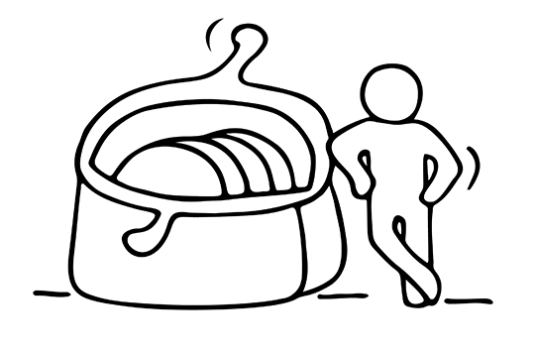
FUNDING NEEDED FOR 4 KEY PHASES
4
FUNDING FOR YOU TO LIVE!
Many women keep on a part time job in the early days
of their business up start to provide a secure income
stream. Having a part time job while starting your own
business is a way of hedging your bets, granting you
some guaranteed income as you work to develop your
business. The most obvious drawback is the time it
takes away from building your business.
Research and take advantage of any funding
initiatives and government funded support service for
small businesses.

Slide 29
WHERE CAN YOU FIND SUPPORT?
The level of complexity of the business idea will mean different levels and approaches for funding support will be pursued. Hence this section is in two parts – 1. LOW START UP INVESMENTS and 2. MORE COMPLEX START UP INVESTMENTS

Slide 30
THE CONTEXT
Starting a business represents a significant opportunity for women migrants or refugees. However, it is known that women still rely on personal savings as their main source of business funding. So, this can be particularly difficult when you are rebuilding a life in a new country.
For all women, regardless of background, there is a fear that they will be turned down or face difficulties when trying to obtain business credit and financing.
LOW START UP INVESMENTS The good news for women business owners is that there is a range of free and low-cost resources available to help them overcome many of these challenges and succeed in business.
MORE COMPLEX START UP INVESTMENTS, many more options also that are available to pursue

Slide 31
LOW START UP INVESMENTS - WHERE CAN YOU FIND SUPPORT?
Traditionally start up businesses might have considered going to their bank for a business capital loan, but banks have become stricter on their lending criteria and are less likely to loan money to an entrepreneur without a long track record.
Luckily, business owners have other options open to them. The key to success is knowing where to look. We will look at some of these options now.
For those women business founders with more complex financial needs, please SKIP to slide 50.
NOTE - all of the content that follows will increase your awareness of different funding mechanisms.

Slide 32
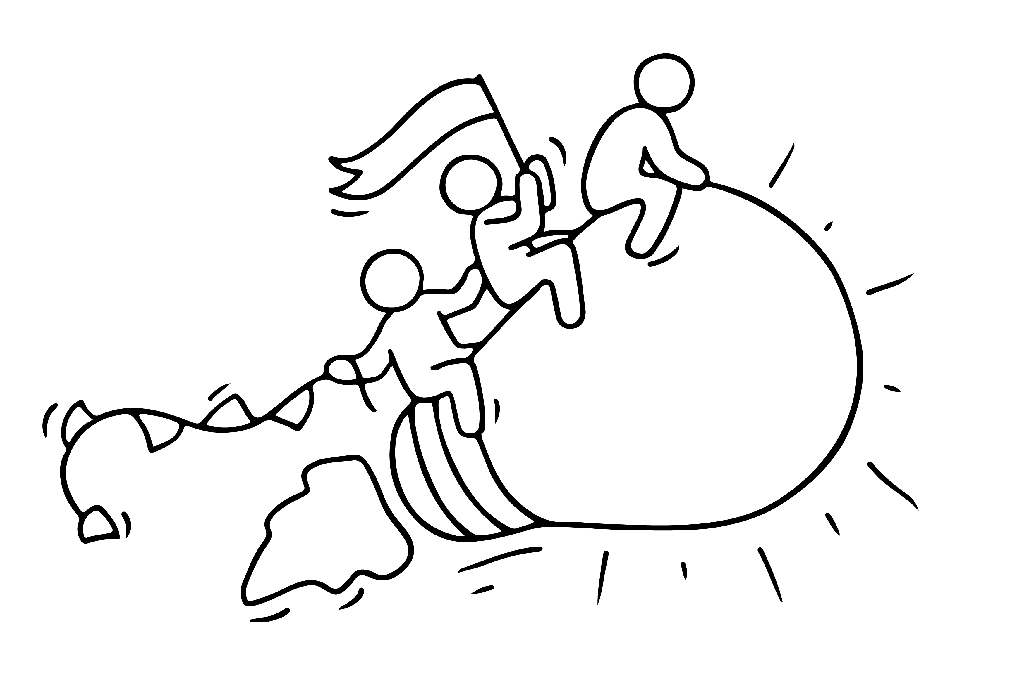
LOW START UP INVESMENTS - WHERE CAN YOU FIND SUPPORT?
In this section, we introduce you to
Private investment friends and family
Micro credit and micro financing
Crowdfunding
Grants

Slide 33
LOW START UP INVESMENTS - WHERE CAN YOU FIND SUPPORT?
Private Investment is often a good option for a new business especially when you can prove the basis of a good business. It also has other advantages such as strong business contacts or advice and help which traditional lenders do not provide.
Many women start close to home with Friends and Family. Make sure to keep your personal and professional relationships as separate as possible by getting everything in writing and clearly explaining the risk involved in investing in a start-up - and make sure they understand they could lose their investment. Don't risk losing friends or family over investments.
.

Slide 34
LOW START UP INVESMENTS - WHERE CAN YOU FIND SUPPORT?
Ask small business groups, and your own Community/Network
You might not know where to begin. It’s probably best to start close to home. Meet with other small business owners or stop into your local Chamber of Commerce or local the state Business Development Office. Many of these organisations offer or can direct you to…
Microcredit usually refers to small loans offered, often without collateral, to an individual or through group lending.
Microfinance refers to a broader range of financial products and services, including loans and other financial supports targeted at low-income clients.

Slide 35
LOW START UP INVESMENTS - WHERE CAN YOU FIND SUPPORT?
EXAMPLE – IRELAND
https://microfinanceireland.ie/ provide small loans through the Government’s Microenterprise Loan Fund. The purpose of the fund is to help start ups and established businesses to get the finance they need for their business
What is a micro-enterprise? It is simply a small business (including a self-employed person) with fewer than 10 employees and an annual turnover of less than €2m. We help these businesses by providing unsecured business loans of €2,000 to €25,000 for commercially viable proposals. Sole Traders, Partnerships & Limited Companies are all eligible to apply.
https://youtu.be/I76rMe4fu-k
MFI can consider applications from businesses that may have been declined a loan from their Bank. They look at each application and base their decision on the viability of the business and your ability to repay the loan.

Slide 36
LOW START UP INVESMENTS - WHERE CAN YOU FIND SUPPORT?
CROWDFUNDING
Crowdfunding is the financing of a new project by raising many small amounts of money from a large number of people. Crowdfunding is not only to great way to raise money online for a business idea or project but simultaneously build up a community and improve visibility/credibility for you and your business.
Is Crowd Funding right for your Business?
Crowdfunding suits certain types of businesses – usually Start-ups or early stage companies that are looking for relatively small amounts of money. Crowdfunding has a higher success rate within certain sectors e.g. creative, craft and food.

Slide 37
LOW START UP INVESMENTS - WHERE CAN YOU FIND SUPPORT?
CROWDFUNDING
Crowdfunding can take the form of:
Charity - when people donate to an individual, project or organisation while receiving no financial or material return in exchange
Pre-selling - when people donate towards the creation of a specific product and they receive the product on release
Peer-to-Peer lending - where each lender gets financial compensation or a return on their investment
Equity lending - when people lend money to individuals or organisations in exchange for company shares
Different platforms facilitate different fundraising models. Finding the right funding model for your project is an important step for a successful campaign.

Slide 38
LOW START UP INVESMENTS - WHERE CAN YOU FIND SUPPORT?
CROWDFUNDING
Different platforms apply different charges depending on the model you chose.
Platform Hosting fee: Some platforms, although not all, charge an initial cost just for hosting your campaign. Top tip - Make sure to ask platform what fee applies to them before starting the campaign.
Success fee: The majority of crowdfunding platforms will take a percentage of the total amount raised. The percentage varies from platform to platform and ranges between 3% and 12% of total raised.
Payment processing fees: Look out also for a service fee for every transaction made. Usually this fee is on average 3%. For instance, for every €100 donation/investment, only €97 reaches the campaign.

Slide 39
LOW START UP INVESMENTS - WHERE CAN YOU FIND SUPPORT?
CROWDFUNDING CASE STUDY UK
AmaElla Organic Cotton Ethical Lingerie
AmaElla designs and produces beautiful lingerie made from soft organic cotton (GOTS certified) - better for the environment, better for the farmers and better for the skin. All products are ethically produced by women, for women.
€14,422 raised, surpassing her goal of €11,100
She attracted small investments from 156 backers (and potential customers)
READ AmaElla Sustainable and Ethical Lingerie — UpEffect | Social Enterprise Crowdfunding (theupeffect.com)

Slide 40
LOW START UP INVESMENTS - WHERE CAN YOU FIND SUPPORT?
Crowd Funding – a good video pitch is key!
Excellent video pitches are essential to successful crowdfunding campaigns.
But pitching your product or service takes practice, preparation and perseverance.
Do your research, by viewing other video pitches.
Write a compelling script that communicates your unique selling points simply and clearly.
Record the vision with passion and enthusiasm – it is infectious and will give the viewer confidence in your commitment
Reshoot it until it’s right.
FOR LOTS MORE TIPS, READ Think Business - Crowdfunding Ireland Guide

Slide 41
LOW START UP INVESMENTS - WHERE CAN YOU FIND SUPPORT?
READ
10 Top Crowdfunding Websites for Entrepreneurs
EXERCISE - Crowdfunding – Exercise
Download and Review Crucial Crowdfunding resources
CRUCIAL Crowdfunding is an ERASMUS+ supported project, designed to inform all the different stakeholders who can potentially benefit from this innovative means of funding business ventures.
CRUCIAL Crowdfunding Project
Crucial Crowd Funding Resources

Slide 42
LOW START UP INVESMENTS - WHERE CAN YOU FIND SUPPORT?
GRANTS
A grant is an award, usually financial, given by a public body or a foundation, to an individual or a company to facilitate a specific business goal e.g. start up, expansion etc. There are many local, regional and national grant opportunities. Start your research on which one is right for you.
SUCCESS IN SECURING GRANT FUNDING
Like making a cake, a successful grant application depends on ingredients (you and your project) and following a good recipe ! In the slides that follow we share our best practice, tips and tricks for grant success. Once you have the ingredients and the recipe right, you will be able to seek funding at a local, regional and perhaps even national level.

Slide 43
LOW START UP INVESMENTS - WHERE CAN YOU FIND SUPPORT?
GRANTS - Interesting video on what a grant does and does not do.
https://youtu.be/q13UX4UCmKY

Slide 44
LOW START UP INVESMENTS - WHERE CAN YOU FIND SUPPORT?
GRANTS
The primary concern of funders is that your business is well planned and that it will be sustainable. In making an effective application, be clear on what you need the funding for…
Fund start up costs - new production facility, purchase new equipment ?
Make a new product range?
Go on a course/ do some training ?
Complete research and development
Up to 50% of applications received by funders do not meet their published criteria. As a very basic minimum you should read the guidelines published by the funder. Consider: the funder’s motivation, the format for applying, the level of funding, submission deadlines, eligibility and the decision-making process.

Slide 45
LOW START UP INVESMENTS - WHERE CAN YOU FIND SUPPORT?
GRANTS
TOP TIP - REMEMBER – ‘PEOPLE GIVE TO PEOPLE…’
Be creative and engaging about your idea, this is your opportunity to distinguish yourself from others. Sell your idea and get the reader interested.
Build your credibility and be professional!
One of the primary reasons why applications get funded is that the funders are convinced that the applicant is well organized and is a capable promoter to carry out the proposed project.

Slide 46
LOW START UP INVESMENTS - WHERE CAN YOU FIND SUPPORT?
GRANTS
TOP TIP - Don’t assume that the funder will have any knowledge of your business or background
Describe your project truthfully and succinctly.
Break down the requirements of the application into bite-sized pieces
Think carefully about presentation; most funders will read many applications and if an application is easy to read and well presented it makes their lives easier.
Do not over-promise - you will one day have to deliver
It always takes a lot longer to put an application for funds together than you think!

Slide 47
LOW START UP INVESMENTS - WHERE CAN YOU FIND SUPPORT?
GRANTS
TOP TIP – Remember, it is competitive
Put your best foot forward
Write your application in an interesting way that captures the energy & spirit of your project (journalist style)
The power of evidence of need. It is not sufficient to say: “we know … we think….” back it up with relevant research
Show that your project is additional – not competing with others
And last but not least, definitely talk to the funding agency before you apply

Slide 48
LOW START UP INVESMENTS - WHERE CAN YOU FIND SUPPORT?
GRANTS
TOP TIP – Remember, it is competitive
Put your best foot forward
Write your application in an interesting way that captures the energy & spirit of your project (journalist style)
The power of evidence of need. It is not sufficient to say: “we know … we think….” back it up with relevant research
Show that your project is additional – not competing with others
And last but not least, definitely talk to the funding agency before you apply

Slide 49
2. MORE COMPLEX START UP INVESTMENTS - WHERE CAN YOU FIND SUPPORT?
While many of the approach's mentioned in the preceding slides apply to all businesses, this section is specifically for deeper learning for more complex start up funding requirements. In this section, we cover
Bank Loan
Private investment - Angel Investors
Venture Capital Investors
Fund Yourself
Government supported Small Business Grants (Covered in Module 3)
Crowd Funding

Slide 50
2. MORE COMPLEX START UP INVESTMENTS - WHERE CAN YOU FIND SUPPORT?
BANK LOAN
A business loan from a bank is a traditional way of financing your business. In most cases, having a robust Business Plan is essential to convince the bank that you are worth backing. Often, a bank will ask for personal guarantees or other forms of security. If you can, never offer security, especially if you are confident Business Plan stacks up. Finally, remember to shop around, there are many banks that may have different lending criteria for new businesses.
Dealing with Your Bank - Do's and Don'ts
Be prepared when meeting your bank
Keep your bank informed in good times and bad times
Choose a bank close to you
Shop around before choosing a bank

Slide 51
2. MORE COMPLEX START UP INVESTMENTS - WHERE CAN YOU FIND SUPPORT?
DEALING WITH A BANK, DOS AND DON’TS
DO
Compare loan packages -Lenders describe the cost of a loan in different ways. Some will tell you the interest rate on the loan, and others may tell you the total amount of money you have to pay back. When lenders describe loan cost in different ways, it makes it difficult to compare your loan options.
Be prepared when meeting your bank
Keep your bank informed in good times and bad times
To make comparison easier, ask the lender to tell you the Annual Percentage Rate (APR) of the loan. APR is the total cost of a loan over one year, including fees. APR can be much higher for alternative lenders that provide fast funding and work with lower credit borrowers.

Slide 52
2. MORE COMPLEX START UP INVESTMENTS - WHERE CAN YOU FIND SUPPORT?
DEALING WITH A BANK, DOS AND DON’TS
DO
Choose between a line of credit and a traditional loan. Depending on your business needs, a business line of credit may be a better option than a loan. A loan is a fixed amount of money that you pay back with interest over a specific period of time; a line of credit is like a credit card. You get approved for a maximum amount of money that you can access as needed, and you repay it over a period of time. The advantage of a line of credit is that you only have to pay interest on the funds you use. A line of credit is better than a loan in two main cases. If you occasionally need short-term working capital to buy inventory or cover seasonal expenses. Loans typically work better when you need to finance a long-term investment, such as equipment or a premises.

Slide 53
2. MORE COMPLEX START UP INVESTMENTS - WHERE CAN YOU FIND SUPPORT?
DEALING WITH A BANK, DOS AND DON’TS
DO
Borrow at the right time: When you are planning about your business loan, make sure that you borrow at the right time. If you take the loan too early, then there are chances that you end up spending most of it for purposes other than what it was meant for. If you borrow it too late then it could put a hold on your business as you will also have to pay the interest at a time when your business can grow exponentially.
Borrow the right amount: too little can result in under capitalisation and that can bring more challenges to your start up

Slide 54
2. MORE COMPLEX START UP INVESTMENTS - WHERE CAN YOU FIND SUPPORT?
DEALING WITH A BANK, DOS AND DON’TS
DON’T
X Mix your Business and Personal account. It's never a good idea to mix your business money with your personal money. You can bank with the same institution if you want, but make sure you open a separate small business bank account. Don't transfer money between the two unless you have an excellent reason and you keep a paper trail.
X Make the mistake of applying to only a single type of lender. Knowing all your options not only makes it easier to decide how to choose an appropriate business loan, but it also increases the chances of getting accepted for a loan.
X Make the mistake of falling for an unreliable lender.
READ - 10 questions you should ask before applying for a bank loan

Slide 55
2. MORE COMPLEX START UP INVESTMENTS - WHERE CAN YOU FIND SUPPORT?
PRIVATE INVESTMENT - ANGEL INVESTORS, BUSINESS ANGELS & PRIVATE INDIVIDUALS
Business angels are private individuals or groups that invest their capital into start-up companies and entrepreneurial ideas in return for partial company management and/or a return on a set amount of the company’s profit (known as an “equity stake”). They often have other benefits for a company, such as experience in the particular sector and often a wide range of industry contacts that can help get your business in motion.
Angel Investment across Europe has taken off over the last few years. Angel investors invest in early stage or start-up companies in exchange for an equity ownership interest. Angel investing in start-ups has been accelerating.

Slide 56
2. MORE COMPLEX START UP INVESTMENTS - WHERE CAN YOU FIND SUPPORT?
PRIVATE INVESTMENT - ANGEL INVESTORS, BUSINESS ANGELS & PRIVATE INDIVIDUALS
CHECK OUT Women Angel Investors | Female Angel Investor
READ
Europe's top angel investors | Sifted

Slide 57
2. MORE COMPLEX START UP INVESTMENTS - WHERE CAN YOU FIND SUPPORT?
PRIVATE INVESTMENT - ANGEL INVESTORS, BUSINESS ANGELS & PRIVATE INDIVIDUALS
CHECK OUT 30 Top Angel Groups + Venture Capital Firms for Women Entrepreneurs — Startup Funding

Slide 58
2. MORE COMPLEX START UP INVESTMENTS - WHERE CAN YOU FIND SUPPORT?
PRIVATE INVESTMENT - ANGEL INVESTORS, BUSINESS ANGELS & PRIVATE INDIVIDUALS
In addition to capital, Angel Investors also contribute their know-how or experience in company management and can offer valuable expertise and guidance. Angels usually seek active participation in the company in which they invest. Angel Investors are primarily motivated by return on investment and Angel Investor involvement can often help secure access to venture capital or classical bank loans.
Business Angels generally invest in the region where they live and in areas in which they have greatest expertise or knowledge.
Some specialise in providing finance in new technologies.
Source: Business Angels (BES, Angel Networks) - Enterprise Ireland (enterprise-ireland.com)

Slide 59
2. MORE COMPLEX START UP INVESTMENTS - WHERE CAN YOU FIND SUPPORT?
The Ideal Angel Investor, Business Angels & Private Individuals will have
A strong commercial track record
Excellent business credentials
Capacity to invest
Ability to identify commercial opportunity
Time to invest in the creation of a new company
Vision to transform new technologies into solid businesses
Established links and relevant industry contacts

Slide 60
2. MORE COMPLEX START UP INVESTMENTS - WHERE CAN YOU FIND SUPPORT?
6 Things Angel Investors, Business Angels & Private Individuals care about the most
The quality, passion, commitment, and integrity of the founders
The market opportunity being addressed and the potential for the company to become very big
A clearly thought out business plan, and any early evidence of obtaining traction toward the plan
Interesting technology or intellectual property
An appropriate valuation with reasonable terms
The viability of raising additional rounds of financing if progress is made
Source 20 Things All Entrepreneurs Should Know About Angel Investors (forbes.com)

Slide 61
2. MORE COMPLEX START UP INVESTMENTS - WHERE CAN YOU FIND SUPPORT?
Angel Investor Networks
Most new businesses will have trouble getting significant amounts of capital, but business angel investment can help companies reach the next level of financing and expansion. Across Europe, Angel Investment Networks allows members to find and connect with other members regarding business investments and funding. Thousands of business angels use the network to search for ideas, and have entrepreneurs signing up on a daily basis.
e.g. Irish Investment Network has over 170,000 registered angel investors. Their site is presented with
Clear listings posted angel investors that entail the details of their specific sector(s)
Potential investment amounts
Desired location of the potential business venture

Slide 62
2. MORE COMPLEX START UP INVESTMENTS - WHERE CAN YOU FIND SUPPORT?
All Your Angel Investor Questions Answered
What are the six most important things for angel investors?
What do angel investors like to initially see from an entrepreneur?
How long will it take to raise angel financing?
What financial questions should the entrepreneur anticipate from angel investors?
What questions should the entrepreneur anticipate about marketing and customer acquisition?
What questions should the entrepreneur expect concerning the management team and founders?

Slide 63
2. MORE COMPLEX START UP INVESTMENTS - WHERE CAN YOU FIND SUPPORT?
All Your Angel Investor Questions Answered
How risky is angel investing?
What questions should a CEO ask of potential angel investors?
What are the key factors in determining the appropriate valuation in a seed round of financing?
What are typical reasons angel investors will reject an investment?
What mistakes are made by entrepreneurs in a pitch meeting with angel investors?
All 20 Sets of Questions & Answers Here: Forbes

Slide 64
2. MORE COMPLEX START UP INVESTMENTS - WHERE CAN YOU FIND SUPPORT?
Venture Capital Investors
Seed and Venture Capital are becoming more frequent sources of investment providing capital for new businesses and entrepreneurs that would not be able to obtain loans. The global credit crunch has increased the demand for angel investors.
Venture Capital is:
Capital provided by full-time, professional firms (venture capitalists) who invest with management in ambitious, fast-growing companies with the potential to develop into significant businesses.
Is likely to add considerably to the credibility of the company and to supply management expertise, support and access to their contacts. As part of their mentoring and monitoring of their investment, they are likely to seek board membership.

Slide 65
2. MORE COMPLEX START UP INVESTMENTS - WHERE CAN YOU FIND SUPPORT?
Venture Capital Investors
In contrast to bank finance, venture capitalists are not looking for scheduled repayment, but for a minority of the share capital of your company in return for cash.
The venture capitalists will typically look to realise their investment in five years, either through floatation on a public market, a trade sale or for their stake to be bought out by the company.
Venture Capital funds usually invest in companies that are raising €500k+ in equity. The companies must be in a fast-growing, attractive sector, with a strong management team and demonstrable skills. The product/service must solve a clearly identified problem.

Slide 66
The Difference Between a Venture Capital and an Angel Investor
Angel Investor |  | Venture Capital
Private equity is simply shares (equity or securities) in a company that is not listed on the stock market
An individual investor Investment amounts: €10k - €100k, sometimes a bit more, groups could go up to €1m Hold private equity from having made investments directly into private companies Individuals often successful business people, who are investing their own personal funds into a potentially rewarding opportunity May be willing to invest in early-stage or start-up, as well as established companies Have experience and contacts to contribute May be willing to be "hands-off" or "hands-on" adding important skills | A company or business rather than an individual Investment amounts: €1M + Hold private equity from having made investments directly into private companies Capital is invested by firms or companies that use other people's money. They raise that money by offering investors a chance to take part in a fund that is then used to buy shares in a private company Seldom interested in early-stage, unless compelling reasons (e.g. high tech with already successful founders) Have contacts Require seat on board | A company or business rather than an individual Investment amounts: €1M + Hold private equity from having made investments directly into private companies Capital is invested by firms or companies that use other people's money. They raise that money by offering investors a chance to take part in a fund that is then used to buy shares in a private company Seldom interested in early-stage, unless compelling reasons (e.g. high tech with already successful founders) Have contacts Require seat on board

Slide 67
2. MORE COMPLEX START UP INVESTMENTS - WHERE CAN YOU FIND SUPPORT?
Y Combinator
Y Combinator provides seed funding for Start-ups. The goal is to get you through the first phase and get you to the point where you’ve built something impressive enough to raise money on a larger scale. Then they introduce you to later stage investors—or occasionally even acquirers.
Make small investments in return for small stakes in the companies funded
Help founders deal with investors and acquirers from well-known technology companies
Twice a year they invest a small amount of money in a large number of Start-ups. Once in January-March and one June-August
During Demo Day Start-ups pitch to a specially selected audience of investors and press
See a list of the benefits and resources available to YC founders here
Apply to Y Combinator, you just fill out an application form
Read More about Y Combinator

Slide 68
OVERCOMING A ‘NO’ WHEN SEEKING FUNDING

Slide 69
OVERCOMING A ‘NO’ WHEN SEEKING FUNDING
If the recipe isn’t right, and you don’t get the Grant, Crowd Fund or place on an Accelerator - be sure to use these rejections as a learning experience! Encountering a no can be disheartening. B
But don’t let it get the better of you. Consider these steps to increase your chances of being reconsidered, improve your potential for obtaining financing in the future and in general, relieve the stress of securing funding.
Reflect on your approach be honest with yourself. Did you rush the application? Did you really think you met the priorities or did you not do yourself justice in writing about your project?
Ask for feedback even if your rejection letter specifies a reason for your rejection, asking for verbal feedback will sometimes bring you a fuller and more open response.

Slide 70
OVERCOMING A ‘NO’ WHEN SEEKING FUNDING
Act professionally even though disheartened, keep your behaviour and actions as professional as possible. If you thank the possible supporter politely for his/her time, and follow up in a few weeks when you’ve gathered more information or adjusted your business model, you may have a much better chance of getting that funding.
Find out what did get funded funders often publish lists of what they did fund
What do you notice about the projects that got funded? Were the businesses at a different stage to you? Were you asking for much more (or less) money than they received? Were you applying for activities that this funder hasn’t supported?

Slide 71
OVERCOMING A ‘NO’ WHEN SEEKING FUNDING
Contemplate Your Options There’s no right or wrong way to pursue funding. If one channel seems to be generating more obstacles than opportunities for progress, it might be time to change up your strategy. Increasing your chances of getting a yes could be a simple matter of choosing the right channel (or group of channels) to use to cultivate funding.
Look At Your Business Model Use the rejection as a learning opportunity. Take a look at your business model for any major flaws or weaknesses. Fixing these gaps will make your overall business idea more attractive to other potential investors, and could be enough to change your initial rejecters’ minds.

Slide 72
BE INSPIRED
WATCH
Empowered women pitch their businesses and share their stories - YouTube

Slide 73
Next Step 5
The Power of Collaborations and Networks
Enjoyed learning about Step 4?
Join in the conversation with your peers on our EMINENT Closed Facebook Group
A safe place to talk about your opportunities and challenges, excitement and fears.

