Slide 1
STEP 2
RESEARCH – DEEP DIVE INTO YOUR BUSINESS IDEA
YOU HAVE A BUSINESS IDEA.
WHAT’S NEXT?
This programme has been funded with support from the European Commission
This project has been funded with support from the European Commission. This publication [communication] reflects the views only of the author, and the Commission cannot be held responsible for any use, which may be made of the information contained therein.

Slide 2
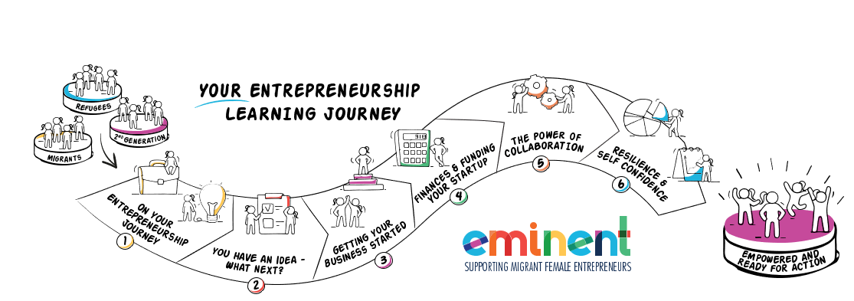
EMIMENT wants to enable Female Migrant Entrepreneurs. We want to bring you on your learning journey to gain the knowledge and skills you need to gain the confidence to establish and successfully run your own business.
Can you? Of course, you can. Open your mind and let us bring you on Your Entrepreneurial Learning Journey, step two…….

Slide 3
IN STEP TWO, YOU WILL LEARN
Pages
Researching and testing your business idea is critical to its success 3- 11
The 4 steps to test and qualify your business idea 12-39
Introduction to market research, practical approaches 40 – 76
Check out your competition 77 - 79
Research in Context
It is important to take into account that each culture has its own peculiarities, approaches and practices, and it might take time to research and learn how to approach potential clients and target groups in your host country.

Slide 4
Researching and testing your business idea is crucial to its success.

Slide 5
DON’T SKIP THIS STEP..
A business idea is a starting point for any current or future entrepreneurs. It is essential because it is the beginning of the life of a business and the life of an entrepreneur.
But now, you need to research and test your business idea/s before you invest any more time or precious money into same.
Do not make the mistake of skipping this step because you are in a rush to launch your product or service. It is akin to pursuing your business journey without a road map.

Slide 6
As we saw in Step 1 On Your Entrepreneurial Journey, your business starts with developing your business idea and before you move forward, that idea needs to be “validated*” that it is worthwhile and will be profitable. Let’s recap how you have arrived at your business idea/s;
You have uncovered a problem; you have found opportunities through personal observation. When the idea is forming, look at the problem it solves. Will people pay you for the solution ? A gap in the market is a place or area that current businesses aren’t serving.
Remember - There may be a gap in the market, but is there a market in the gap? It could be a gap for a reason!
* demonstrate or support the value of.

Slide 7
2. Drawn on your own personal experiences; many of the most powerful world changing ideas come from the experiences and challenges an entrepreneur has faced in their own life. Take a moment to consider the problems you are currently dealing with. Chances are, you’re not the only woman facing these issues.
3. Improving an existing product or service; your business idea does not have to be a new product or service. It may take an existing product or service that you improve, make cheaper, faster, leaner and basically giving the consumer a better product experience.

Slide 8
“The best businesses come from
people’s bad personal experiences.
If you just keep your eyes open,
you’re going to find something
that frustrates you, and then you think,
‘well, I could maybe do it better
than it’s being done,’
and there you have a business ”
Richard Branson

Slide 9
But we are not like Richard Branson!
We love this video from Sahar Hashemi | TEDxYouth who considers why she is not like Richard Branson but is credited with bringing coffee cafe culture to the UK in the 90′s with her chain Coffee Republic.
WATCH
Sahar’s book, written with her brother Anyone Can Do It is excellent read

Slide 10
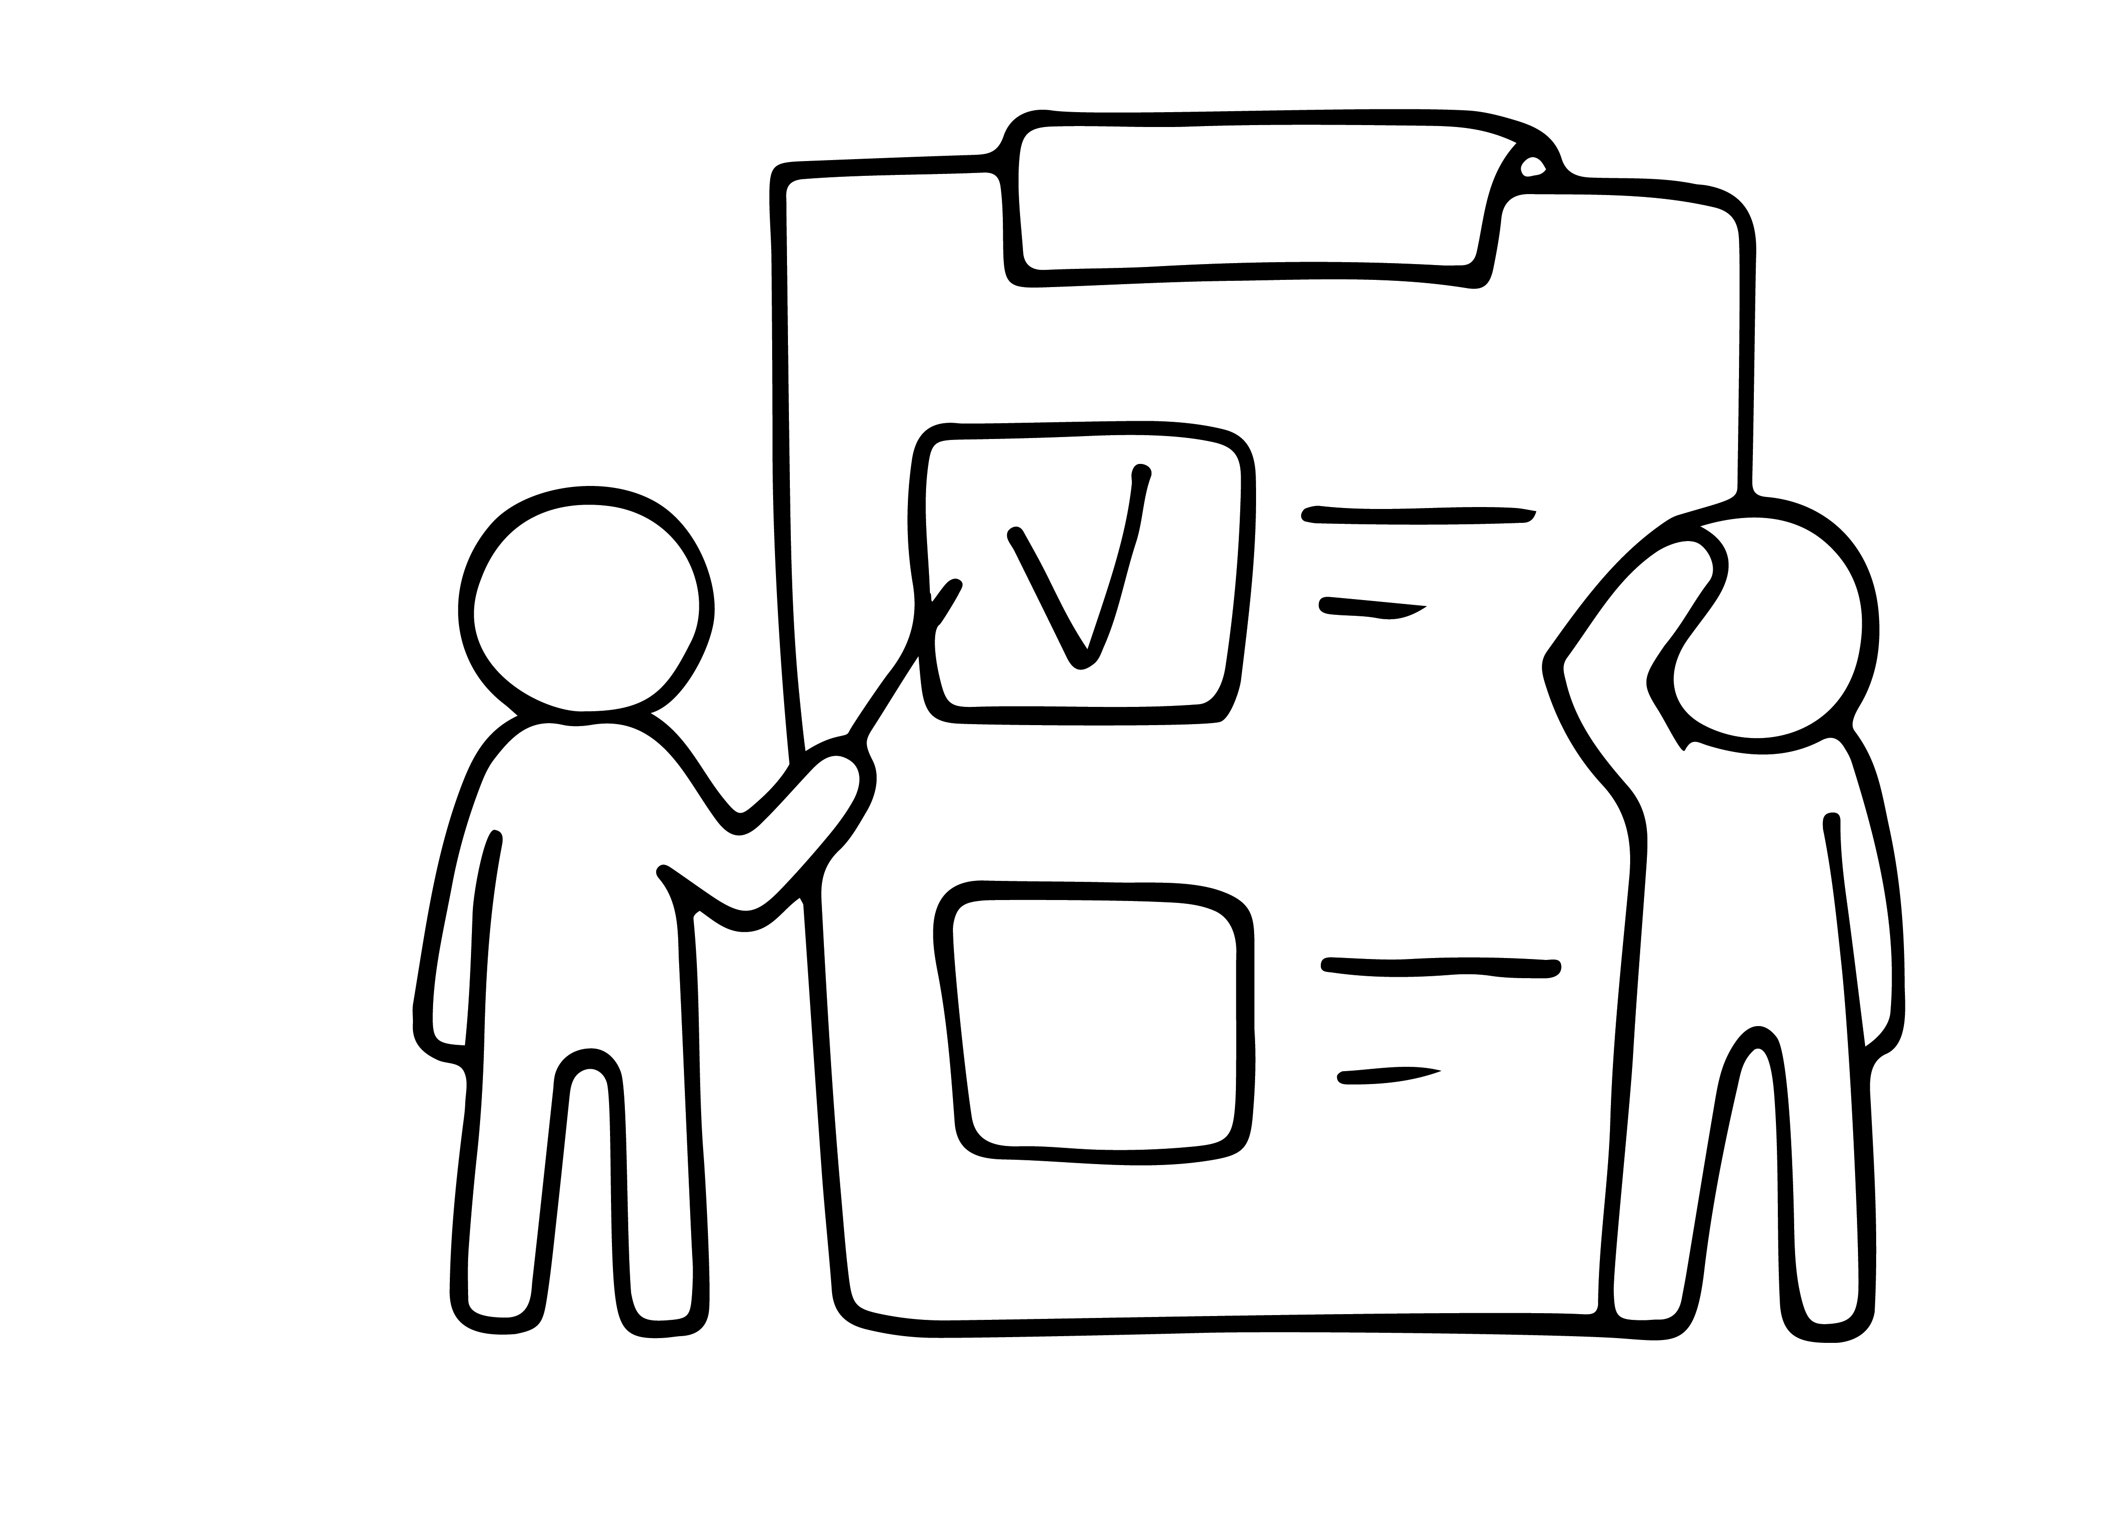
KEY TIP
LOOK FOR IT –
Does it already exist?
Even the simplest search for the keywords of your product or service idea on Google or YouTube, can yield interesting results. If it does exist do not give up on your inspiration.
Perhaps there are ways to improve on the existing product?
Can you offer value to the business already producing it?
Could the market be satisfied better/ smarter?
If you answered "yes”, move step by step through the process of testing/validating your idea

Slide 11
SOME READING FOR DEEPER LEARNING
10 Great Ways to Generate Business Ideas
https://www.entrepreneur.com/article/74184
19 Fresh Ways to Find a Business Idea
https://entrepreneurshandbook.co/19-fresh-ways-to-find-a-business-idea-d52c115d6419

Slide 12
YOUR 4 STEPS TO TEST AND QUALIFY YOUR BUSINESS IDEA

Slide 13
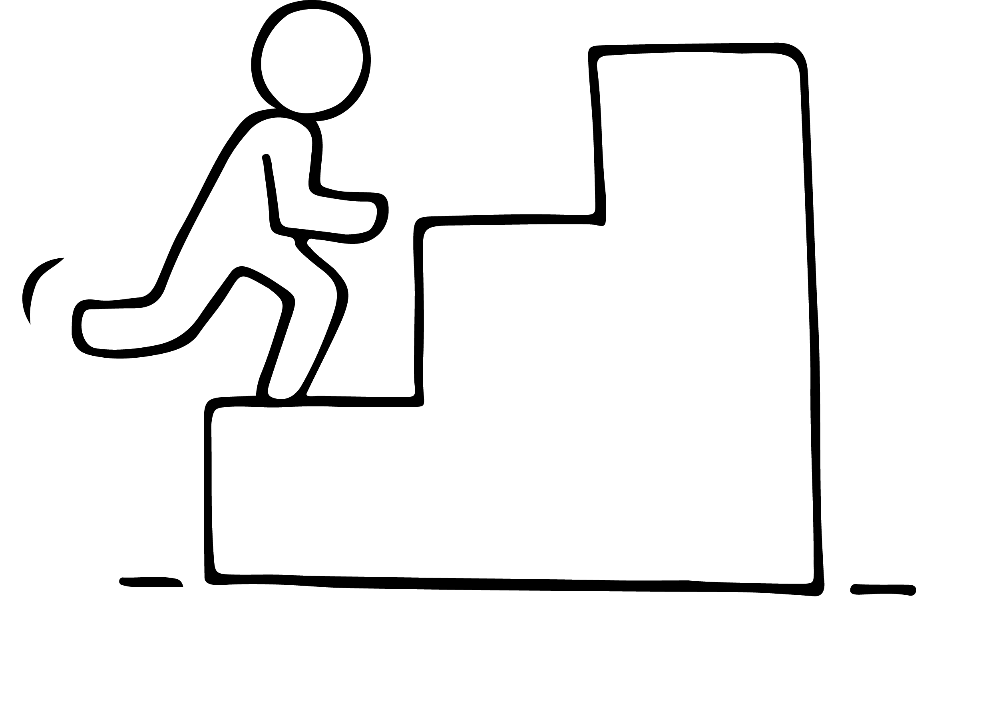
4 STEPS TO TEST AND QUALIFY YOUR BUSINESS IDEA
STEP 1: Really define your business idea
STEP 2: Remind yourself why you need to test your business idea!
STEP 3: How to evaluate/test your business idea
STEP 4 Identify and define your target market

Slide 14
STEP 1: DEFINE YOUR BUSINESS IDEA
Before you test or qualify your business idea, you need to clearly DEFINE the idea;
A key skill for any entrepreneur is to be able to effectively and easily explain your idea to others. As your business takes off, you will need to explain your idea to potential customers, mentors, banks and finance etc., in a way they will clearly understand and buy into your idea with full confidence.
7 key tips....
1. Keep it short. Your explanation should not be more than a few sentences.
2. Identify the problem you are solving. In one sentence, explain the problem your potential customers are experiencing.
3. Simply explain your solution. In one sentence, explain how you solve the problem you’ve just outlined.

Slide 15
STEP 1: DEFINE YOUR BUSINESS IDEA
4. Explain what your solution means for your customers. In one sentence, what is the end result of your service or product? Does it save money, make their life easier or give them new opportunities?
5. Personalize it. If at all possible, make your explanation relate to the person you are speaking to. Has the problem you are solving affected them? Do they know anyone with this problem? The more interactive you can make your definition, the higher the chances that your audience will be receptive to it.
6. Use storytelling to your advantage. Does your product have a backstory that’s particularly special to you? Chances are it will be particularly special and endearing to your audience, too. Use that story in your business idea description to add more character to your item, engage your audience and win hearts and minds.

Slide 16
STEP 1: DEFINE YOUR BUSINESS IDEA
7 Think visually. Add graphics and images
SOME APPROACHES YOU COULD USE
The Founder Institute’s One-Sentence Pitch Format (one sentence)
Startup name, is developing (a defined offering), to help (a target audience) (solve a problem)
2. Describe ideas by answering these questions
* What is the problem you want to solve?
* Who experiences that problem ?
* How you want to solve that problem ?
* Why yours is a better solution ?

Slide 17
STEP 1: DEFINE YOUR BUSINESS IDEA
READ 7 Ways to Refine your Business Idea by Liz Huber
Get so clear on your business idea that you can describe it in one single sentence. You can use this template:
(“My company, _(insert name of company)_, is developing _(a defined offering)_ to help _(a defined audience)_ _(solve a problem)_ with _(secret sauce)_”).
This exercise helps you to get really, really specific and forces you to clearly articulate how you are delivering value to a specific group of people.
LINK TO THE ARTICLE

Slide 18
STEP 1: DEFINE YOUR BUSINESS IDEA
EXAMPLE
“My name is Chanelle. I'm the founder of Sport Up, a UK-based start-up that specializes in sports nutrition. I am working to create an app for iOS/Android that offers on-demand delivery of sports nutrition products especially beneficial to women aged over 40. My goal is to help women build muscle mass in a safe and cost-effective way.”
EXERCISE
Define your business idea using this formula

Slide 19
STEP 2: REMIND YOURSELF WHAT YOU NEED TO TEST YOUR BUSINESS IDEA
Many entrepreneurs lose valuable time and money in developing a concept, product or service only to find that that it isn’t needed, doesn’t address the problem the best way, and isn’t seen as valuable to the users
It is important during this process to keep an open mind and don’t be afraid to change direction.
By all means dream big, but always test, test, test those ideas before you waste time, money, self-confidence, enthusiasm and energy.
Knowing what NOT to do is the mark of a successful businesswoman!

Slide 20
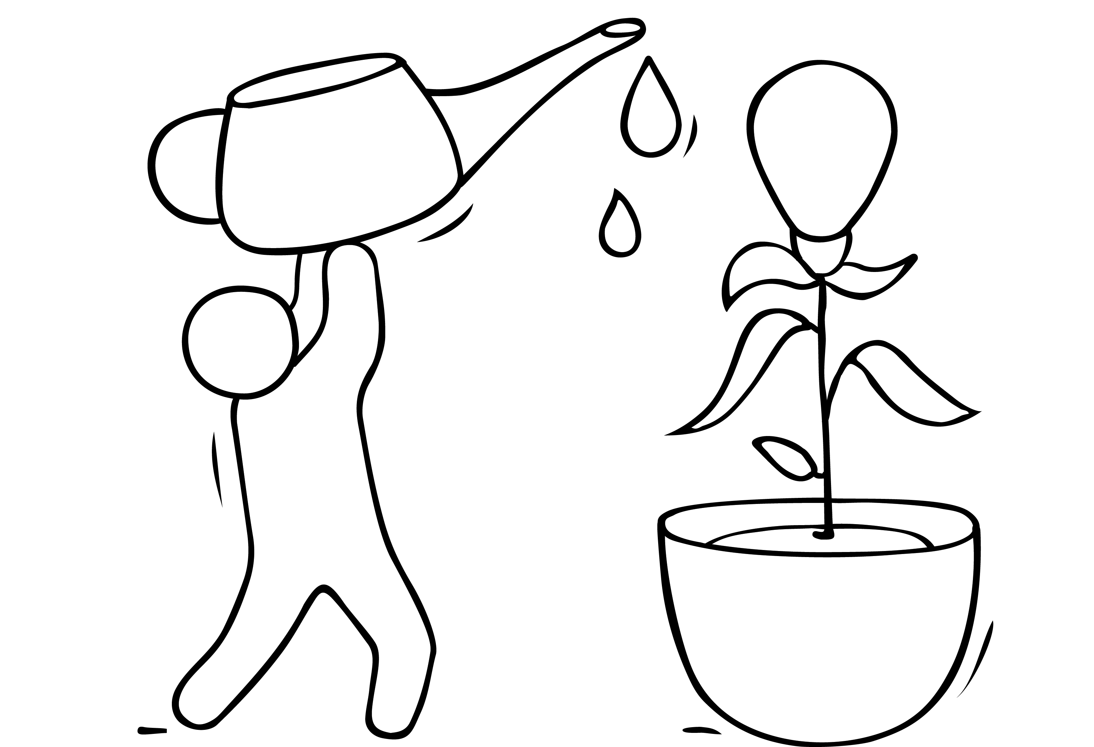
STEP 2: REMIND YOURSELF WHAT YOU NEED TO TEST YOUR BUSINESS IDEA
Qualifying Your Business Idea is the process of testing or validating your idea prior to launching your business, product or service.
Qualifying your business idea is designed to give you reasonable certainty your business will have a sustainable, growing, paying customer base in a sort time period, rather than wasting months or years building a final product nobody will pay for.
It’s as much a way of thinking, as it is a step-by-step process.
Identify Target Market - who is your customer ?
Research and test your product/service with this potential customer
Research your competition thoroughly
Is there money to be made ? Test its financial basis.

Slide 21
STEP 3: HOW TO EVALUATE/TEST YOUR BUSINESS IDEA
There are a number of ways you can research, evaluate and decide if your idea has business potential;
Create a profile of your paying customer
Describe the features/benefits of your product/service
Define the geographic area you intend to sell to during your first year
What competitors are selling to this geographic area?
What price do these competitors charge?
Estimate what price you can charge and still remain competitive
Why would your customers buy from you instead of your competition?.....
Download this useful Guide to Evaluating your Idea.
Credit: Local Enterprise Office, Ireland

Slide 22
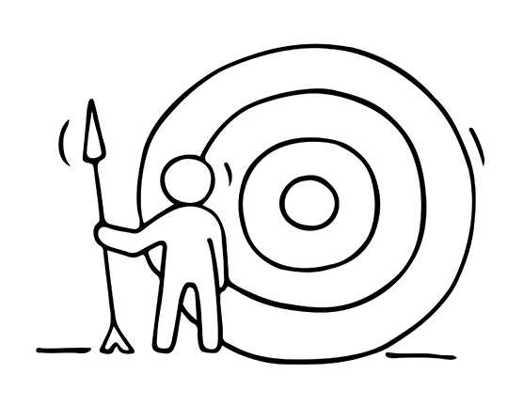
STEP 4 IDENTIFY AND DEFINE YOUR TARGET MARKET
What is a target market ?
A target market is a set of individuals sharing similar needs or characteristics that your business hopes to serve. These individuals are usually the end users most likely to purchase your product.
Identifying a target market helps you find your potential customers and develop effective marketing approaches that will capture their interest. The more specific you are on your target market, the better. You can’t afford to target and market to everyone. Targeting a specific market does not mean you are excluding others but it does help you concentrate on high potential sales.

Slide 23
Mass Market or Niche ?
Your business idea could be focused on a mass market - the market for goods that are produced in large quantities for a significant number of customers. For example, in the chocolate market, this would be the plain chocolate bar. Over 90% of the sales of plain chocolate bars are made by three dominant producers – Cadbury's, Nestle and Mars.
Or it is more likely your start up business idea is targeting a niche market. In our chocolate example, this would be a specialist chocolate (e.g. luxury, organic or fair-trade chocolate).

Slide 24
FINDING YOUR NICHE
Excellent video giving an excellent introduction to the importance of a niche market.
Credit: Shopify

Slide 25
FINDING YOUR NICHE – look at the trends
The narrower you can define your target market, the better. Our Shopify video shares one emerging niche ….
Conscious consumers
Sustainability has become a hot topic among consumers of late. According to a survey by IBM, nearly six in 10 consumers were willing to change their shopping habits to reduce environmental impact.
The rise of the conscious consumer has paved the way for vegan, eco-friendly, and cruelty-free variations of conventional products. If there is a product that is frequently purchased by the mass market, there is likely a niche of conscious consumers that will embrace a greener alternative.
PRODUCT IDEA - Bee’s Wrap is looking to replace plastic wrap with options made from beeswax. This natural alternative to food storage is not only environmentally friendly but also more cost effective for consumers because it’s reusable.. READ MORE

Slide 26
IDENTIFY YOUR TARGET MARKET
There are two basic markets you can sell to Business to Consumer (B2C) and Business to Business (B2B).
Potential customers base; Who do you see as your customers? Do you think they will buy from you? Why? Look for common characteristics and interests. Which ones will bring the most business?
Check out your competition; Who are they targeting? Who are their customers? Don’t go after the same market. Go fine a niche market they are overlooking.
Analyse your product/service; write out a list of your features and benefits. Make a list of people who have a need for these. Describe them, consider their; age, location, gender, income level, occupation, ethnic background

Slide 27
MARKET RESEARCH - WHY IT IS NEEDED?
help provide you with answers; the potential of your market and the types of demand for what types of products.
assist and improve your decision making
provide you with practical, implementable solutions
consumer suggestions that are required to tackle their problems

Slide 28
Research the big picture first
How large is your market?
Who are your potential competitors?
Check Google Trends. Sign up for Google Alerts. Sign up for Google AdWords and use the Keyword Planner tool for inspiration. Google “XYZ industry report” or “XYZ market analysis” to get statistics and data about your market. Pay attention to the related search terms Google shows you at the bottom of your search result page. Do research on a business that does something similar to yours and its competitors.
Research and dig deep.

Slide 29
YOUR TARGET MARKET
CAN YOU ANSWER YES TO THESE QUESTIONS?
✓ Is there an upward trend and industry growth related to your idea?
✓ Can you find existing businesses in your market that are already doing well to demonstrate there’s indeed market demand?
✓ Are there meaningful differences between what’s in the market and what you’re thinking of offering? (“Seems to be” is good enough for now).

Slide 30
IDENTIFY YOUR TARGET MARKET
Consider their personality, attitudes, values, interests, hobbies, lifestyle , behaviours
How you fit their needs; how and when they will use your product? What is most appealing to them? What media do they use to get information?

Slide 31
IDENTIFY YOUR TARGET MARKET
Evaluate your decision;
Once you've decided on a target market, be sure to consider these questions:
Are there enough people who fit my criteria?
Will my target really benefit from my product/service? Will they see a need for it?
Do I understand what drives my target to make decisions?
Can they afford my product/service?
Can I reach them with my message? Are they easily accessible?
Don't break down your target too far! Remember, you can have more than one niche market.

Slide 32
THE PROCESS TO DEFINE YOUR TARGET MARKET
Lynda Falkenstein, author of Nichecraft: Using Your Specialness to Focus Your Business, Corner Your Market and Make Customers Seek You Out promotes a seven-step process, five of which are relevant to us:
Geographic location*
Where are they?
Where do they live?
Where do they visit?
Where do they buy?
1. MAKE A WISH LIST
With whom do you want to do business?
Be as specific as you can: Identify the geographic location* and the types of businesses or customers you want your business to target. If you don't know whom you want to do business with, you can't make contact.
"You must recognize that you can't do business with everybody"
Otherwise, you risk exhausting yourself and confusing your customers.

Slide 33
DEFINE YOUR TARGET MARKET
2. FOCUS
Examples of
skills* needed;
curiosity,
time management,
strategic thinking,
efficiency,
resilience,
communication,
networking,
finance,
branding,
sales
Clarify what you want to sell, remembering:
You can't be:
all things to all people and
"smaller is bigger."
Make a list of what you do best and the skills* essentially needed in each. List your achievements and what training you may need to attain the necessary skills required

Slide 34
DEFINE YOUR TARGET MARKET
2. FOCUS
Identify the important lessons you have learned in life that can assist you with your idea, use them to your advantage
Look for patterns that reveal your approach to resolving problems, be aware of this, you may need additional help
Your niche should arise naturally from your interests and experience and what you are passionate and good at

Slide 35
DEFINE YOUR TARGET MARKET
Customers Perspective* measures the business idea through the eyes of its customers, so that the company retains a careful focus on customer needs and satisfaction. To achieve the best in business performance, you must incorporate reasonable customer needs and wants consistent with your mission and must take them into account in all company decisions.
3. DESCRIBE THE CUSTOMER'S WORLDVIEW
A successful business uses what Falkenstein calls the Platinum Rule:
"Do unto others as they would do unto themselves.”
When you look at the world from your prospective customers' perspective*, you can identify their needs or wants. The best way to do this is to talk to prospective customers and identify their main concerns.
The customers perspective is always first the business follows.

Slide 36
DEFINE YOUR TARGET MARKET
4. SYNTHESISE
At this stage, your idea should begin to take shape as your ideas and the client's needs come together to create something new. A good idea has five qualities:
It takes you where you want to go - in other words, it is in agreement with your long-term vision.
Somebody else wants it - namely, customers.

Slide 37
DEFINE YOUR TARGET MARKET
4. SYNTHESISE
It's carefully planned – in all business capacities
It's one-of-a-kind, the "only game in town’’, this creates higher demand and you become the ‘go to’
It can evolve, allowing you to develop different profit centres and still retain the core business, thus ensuring long-term success

Slide 38
DEFINE YOUR TARGET MARKET
5. EVALUATE
Now it's time to evaluate your proposed product or service against the five criteria in Step 4 Synthesise. Perhaps you'll find that the niche you had in mind requires more development resources than you're ready for. That means it doesn't fulfil one of the above criteria. Scrap it, and move on to the next idea.

Slide 39
EXERCISE QUALIFY YOUR BUSINESS IDEA
ASK YOURSELF THESE QUESTIONS
Put in writing the answers to these questions – it is the very start of your business plan…
1. What problem are you solving?
2. How many specific benefits for your product or idea can you list?
3. Can you state, in clear language, the key features of your product or service?
4. Who are your potential competitors?
5. What key features does my product have that others will have a hard time copying?
6. Do you have access to the various resources you need to launch a business?

Slide 40
INTRODUCTION TO
MARKET RESEARCH
(how to do it formally and properly)

Slide 41
The Business Value of Curiosity
There is a theory. You can't possibly be successful in business if you're not deeply curious about other people.
“Enjoy every step you take. If you're curious, there is always something new to be discovered in the backdrop of your daily life.” ― Roy T. Bennett, The Light in the Heart
Market research is the ultimate curiosity. It is a formula that can be easily learned and applied. Explore it with us ….

Slide 42
MARKET RESEARCH – WHAT YOU NEED TO KNOW
It is important to research the market before starting a new business, launching a new product, or service as it gives you real figures = data = power.
Market Research is a very important step in your business start-up. It is a process of acquiring detailed information of all the areas of your potential customers or target market, their needs and preferences. It allows you understand why they need it, when and where people buy certain things and how they use them.

Slide 43
MARKET RESEARCH – WHY IT IS NEEDED ?
Market Research is a logical and systematic search for new and useful information for your business. It is extremely important and useful to;
Measure the risk so you can decide if the risk is worth it and you will proceed or not with your business idea
Inform you as to who your target audience is; who is the most profitable and valuable customer allowing you to align your products and services to their needs and wants
Asking your audience specific questions will get you valuable and honest feedback directly.

Slide 44
MARKET RESEARCH – THE DIFFERENT TYPES
Two main types of market research
Qualitative research
(the WHAT)
+
2. Quantitative research
(the WHY)
each type has different types of techniques, tools, and methods.

Slide 45
MARKET RESEARCH
QUANTITATIVE V QUALITATIVE RESEARCH
Quantitative Research: THE WHAT
Get reliable, facts and statistics to guide key business decisions e.g., how many target customers care about this benefit? All findings are factual, often numerical Examples; numbers, statistics, data, charts
Quantitative Research involves collecting data through desk research, surveys, questionnaires.
Your job is to find it, organize it, analyse it and communicate it simply. This is the ‘what’.

Slide 46
MARKET RESEARCH
QUANTITATIVE V QUALITATIVE RESEARCH
Quantitative Research: THE WHAT
Get reliable, facts and statistics to guide key business decisions e.g., how many target customers care about this benefit?
Quantitative Research involves collecting data through desk research, surveys, questionnaires.
Your job is to find it, organize it, analyse it and communicate it simply. This is the ‘what’.

Slide 47
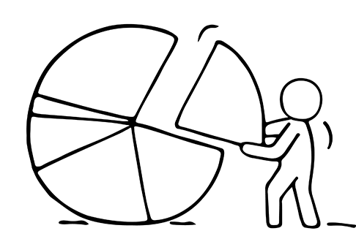
Quantitative Research
- FIND BUSINESS DATA
Business data; the information about people, places, things, business rules, and events in relation to operating a business. Data is filled with potential if you can learn to get at it.
The role of data is to empower you to make decisions based on facts, trends and statistical numbers. But with so much information out there, you must be able to sift through the noise, and get the right information, so that you can make the best decisions about strategy and growth.

Slide 48
RESEARCH & TEST TARGET MARKET
ANALYZING THE DATA
Analysing the data is where it gets interesting. Bring together the useful information, arrive at conclusions and support decision-making.
It is a good idea to create a high-level summary that includes key findings and how your business responds to same.

Slide 49
MAIN TECHNIQUES
Quantitative research examples;
The market itself; read about your niche in trade magazines/ national press/consumer media but always trace back to original source.
Sector bodies e.g. food, craft and design, retail, engineering – at regional and government level also industry associations for the sector you are focused on
Our friend Google which can lead you to market research reports such as Mintel, Foresster

Slide 50
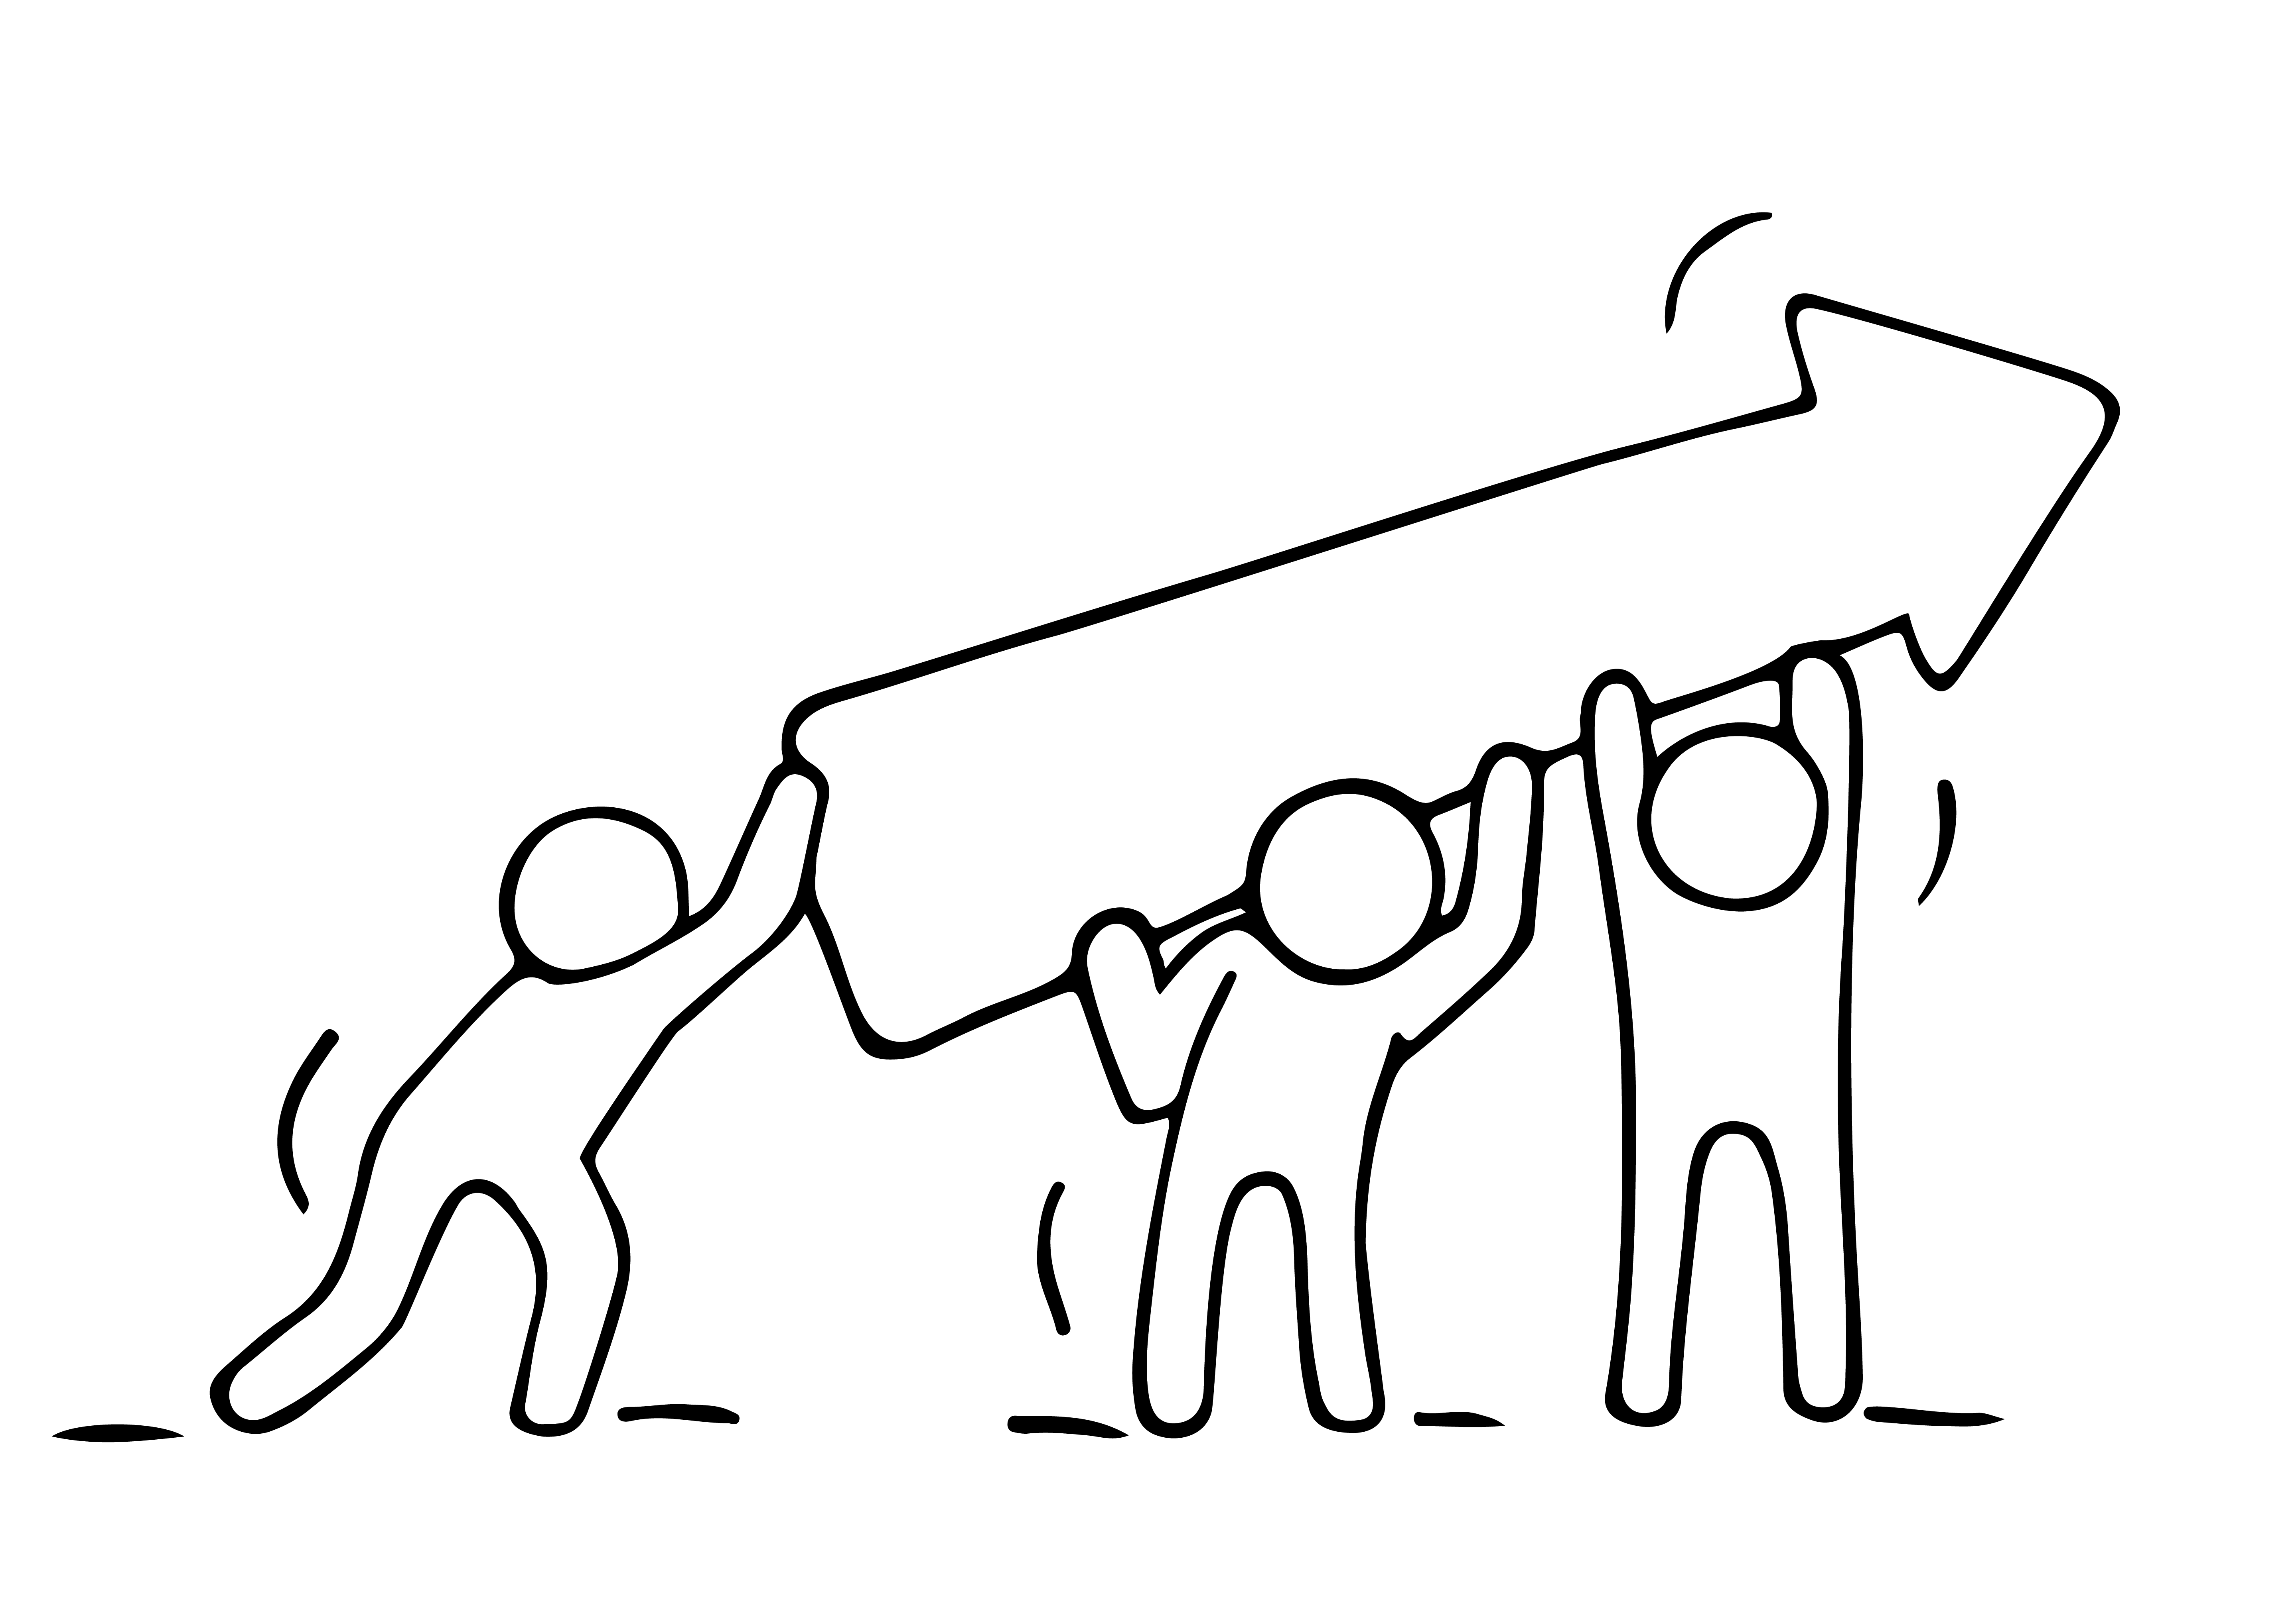
MARKET RESEARCH
QUANTITATIVE RESEARCH
THE WHY
The purpose of qualitative research is to get a deeper understanding and insights to a customer reason to purchase or behaviour. This is the ‘why’. e.g. what they like/dislike, what they think of a product etc. It determines customer motivation or decision making through close observation e.g. in a small group, interviews or face-to- face encounter.

Slide 51
QUALITATIVE MARKET RESEARCH
Based on your own market research, not statistically valid
Examples; hearts, minds, opinions, motivations, attitudes
Example Question;
Does anyone want it?
Will they buy it ?
What do they think?
How do they perceive my offering?
What is their opinion or attitude?

Slide 52
MARKET RESEARCH
QUALITATIVE RESEARCH
Qualitative research, as Steve Blank puts it, “get out of the building.”
An example would be talking to 20 people about your idea.
Open with: “Hi, I’m a researcher doing a project on XYZ. Can I ask you a few questions?”
If they say yes, the next question is to ask their consumption habit for your product idea
WATCH
Serial entrepreneur Steve Blank explains how entrepreneurs fail when they wait too long to gauge real customer interest in their products.

Slide 53
.
Do they use XYZ product (your competitor)? Why or why not?
When do they use XYZ? Is there anything frustrating about using XYZ?
Their answers will tell you if they are your target customer and if there is anything missing in the market that you can offer. Once you understand who you are talking to, explain your idea to them succinctly, ask “what do you think of this” and then listen. Always dig deeper, if they say “that’s a great idea”, ask why.

Slide 54
MARKET RESEARCH
QUANTITATIVE V QUALITATIVE RESEARCH
Typically, robust market research will include both quantitative and qualitative research methods.
They equally provide valuable insights.
Determine what information the business needs first. What is the purpose and what do you hope to achieve i.e. insights, information?
Who needs to be researched and how many?
How long do you have ?

Slide 55
MAIN TECHNIQUES of QUALITATIVE RESEARCH
Depth Interview
Focus Group
Market Research Online Communities (MROC) e.g. LinkedIn Groups
“Listening Platforms” i.e. blogs, forums etc
Questionnaires / Surveys - Online, face to Face, telephone or post
Mystery Shopping
Observation

Slide 56
ONE TO ONE INTERVIEW
ONE TO ONE INTERVIEW
Conduct a one-to-one interview by asking your interviewee a set of semi- structured, probing questions usually face-to-face.
You need good interpersonal and listening skills
Advantages: flexibility, can collect lots of in-depth info from one person.
Watch for your own interviewer bias

Slide 57
FOCUS GROUPS
Recruit relevant participants – these are your community of interest
Pick convenient venue, day and time (Can be in someone’s living room, zoom, evenings etc)
Facilitator is key role (someone you trust)
Plan topics to probe and set schedule
Welcome participants, permission to record
Facilitator sets atmosphere and tone of the consultation
Thank-you, reward – product/service giveaway (collect feedback and permission to use in marketing)

Slide 58
Good ideas can be validated from discussions amongst communities-of- interest. Start by getting early feedback from your target market to make sure you are doing/building something they actually need and want enough to pay for.
Step 1: Develop an initial list of consultees
(min 20) what they think about your idea so you get a good idea what your key selling points are, the main problems you are seeking to address, finding out about your competitors, identifying frustration
Step 2: Be prepared and write up a list of specific questions starting with how, what, why, when, who, where (Who was involved? What happened? Where did it take place? When did it take place? Why did that happen? Robinson has developed a list of 20 key questions that you can adapt.
Also see 12 Great Customer Interview Questions as a Guide.

Slide 59
MARKET RESEARCH EXAMPLES
In this section you will learn the a few
Market Research Methods;
Questionnaires (on/offline)
Mystery Shopping & Observation
Market Research Online Communities (MROC)

Slide 60
THE POWER OF QUESTIONNAIRES
QUESTIONNAIRES ARE;
Easy to analyse
Large numbers of targeted customers
can be contacted at a relatively low cost
Easy and affordable to administer
Format is easy and familiar to respondents
Can get a great variance of large
amounts of information in a short period of time
Gives customers a chance to respond in their own time

Slide 61
THE POWER OF QUESTIONNAIRES
CONSIDER WHEN DEVELOPING
What are the key pieces of information you need?
Aesthetics & flow– it must be appealing and user friendly. Consider the logical flow of these questions
Are they yes/no answers, multiple choice or do you need more information?
Use variety of styles to keep interest levels up. Start with general easy questions and move on to more sensitive ones
Encourage Response Rates - Appeal to ego, forewarning, respond by dates, incentives, prizes, confidentiality

Slide 62
ONLINE RESEARCH TOOLS
BENEFITS
Speed; in one place on the web, just need a computer with internet, no travel required
Affordable; costs next to nothing
Accuracy; ability to receive information directly from your audience eliminates errors. Customers more likely to be honest. So, you get the exact data you need. Make sure you ask the right questions in the right way
Easy to use, design, flexible, look professional

Slide 63
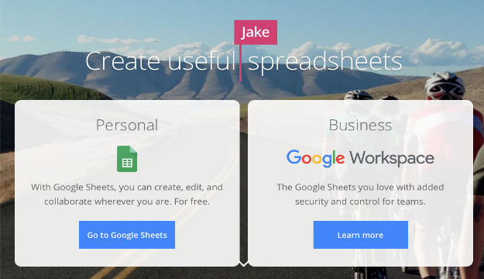
THE POWER OF QUESTIONNAIRES
ONLINE RESEARCH TOOLS
FREE Online Package
Easy-to-create surveys and forms for everyone
Create custom forms for surveys and questionnaires at no cost.
Gather everything in a spreadsheet and analyse data directly in Google Sheets

Slide 64
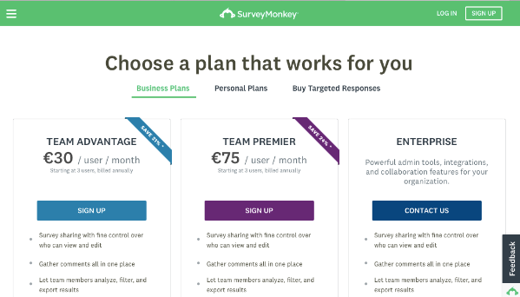
THE POWER OF QUESTIONNAIRES
ONLINE RESEARCH TOOLS
FREE ONLINE PACKAGE
Cost; FREE. Enhanced plans with additional services circa €200 per annum
What It Is; an online survey and opinion poll service

Slide 65
THE POWER OF QUESTIONNAIRES
ONLINE RESEARCH TOOLS
How to Use It; you can creative surveys free of charge for your own audience. For a fee, you also can get feedback from your target audience via SurveyMonkey's own samples
Get the Most Out of It; beyond the answers to survey questions, respondents may provide additional insight in their open-ended comments
www.surveymonkey.com

Slide 66
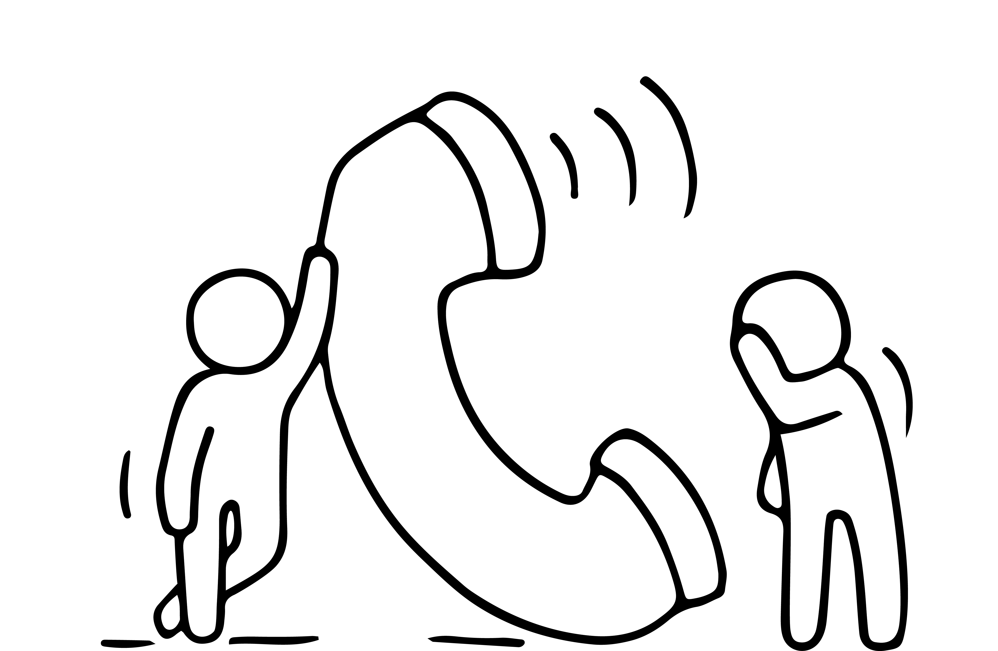
HOW TO FIND PEOPLE TO INTERVIEW
COLD CALLING:
If you are targeting a business market, the most direct method is cold-calling companies. Ask for the person with the appropriate title and tell them that you are seeking their advice on a new product. People are more likely to talk to you if you are seeking their advice than they will be if you are trying to sell them a product.
ADVERTISING:
On-line advertising is the fast and very targeted. To find the right audience through use advertising in an online publication that goes to your target market. You may need an incentive for people to sign up for the interview. E.g. this could be the members of a Chamber of Commerce.

Slide 67
HOW TO FIND PEOPLE TO INTERVIEW
USE YOUR NETWORK; your industry contacts and their contacts.
Be sure to let your interviewees know when you plan on conducting the interviews. Set up appointments as soon as possible and let them know how much of their time it will take. It is ideal to do some number of the interviews in person.

Slide 68
BUILDING THE QUESTION SET
Questions are important; the most important part of the market validation is the questions that you ask and how you ask them. Unlike a scientific survey, you are trying to understand the emotions of your target market. You will want to ask open-ended questions that get them to talking about how and why they do things and what will make them buy your product.
Whether you are trying to validate your target market or your positioning, a fundamental question that you should always ask is, "What keeps you up at night?“ The answer may have nothing to do with your product, but it will tell you where their priorities will be when considering any product or service.

Slide 69
BUILDING THE QUESTION SET
You will want to have many questions that are specific to your product including questions about their environment (which will tell you how easy it will be to add your product to their environment), cultural issues (which will tell you how easy it will be to adopt your product), and budgeting (which will tell you if people actually have the money to buy your product).

Slide 70
BUILDING THE QUESTION SET
Beyond the basic first question, you will need to construct questions that allow you to try out your product positioning and/or target market.
Here are some example questions:
Will you have a need for the [product/service]?
Can you tell me what this is?
Am I missing anything?
What do you most desire/need/want?
What frustrates you most about...?
Are you looking for something like...?

Slide 71
BUILDING THE QUESTION SET
Don’t forget to ask them:
Who they are?
What they do?,
What they want?
What their budget is?
How much they are willing to pay? Etc.

Slide 72
EXERCISE – PUT TOGETHER THE QUESTIONS YOU NEED
Here are a few of the top questions you should be asking your target consumers, with the goal of learning more about their motivations and needs as it pertains to your business idea:
What are you most looking to achieve (as it pertains to your product area)?
What are some of the current solutions you're using, or have used in the past?
What frustrates you most about current solutions out there?
What features would you most like to see (as it pertains to your product area)?
Do you have any fears (as it pertains to your product area) holding you back?
Would you be willing to pay for a solution that does XYZ for you?

Slide 73
TESTING THE QUESTION SET
It is important to test the question set.
It is very hard to get it completely right the first time. You will also find that after some initial interviews will probably make you realize that there is other information that you want to gather.
It is a good idea to run three to five test interviews, then review your questions and findings and make sure that you are getting the results that you want from the questions.

Slide 74
TESTING THE QUESTION SET
The following are some things to consider during this review:
Are the questions open-ended enough to start a dialog?
Are some questions unnecessary?
Is this the right target market?
How long are the interviews taking?
Have I uncovered something in these interviews that I need to ask some more detail about?
Which questions were misunderstood and how can they be reworded?

Slide 75
MYSTERY SHOPPING & OBSERVATION
One of the most valuable ways to understand your market is to spend time in retailer outlets, portfolio websites and trade fairs to see at first hand who your competitors are and what they are doing.
Are there many new products being launched?
What is the brand leader doing?
Are there many promotions?
Which lines are being given most space/coverage? (These are usually the best sellers!)

Slide 76
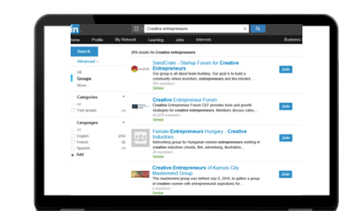
RESEARCH & TEST TARGET MARKET
MARKET RESEARCH ONLINE COMMUNITIES (MROC)
Use social media, blogging, online forums, and any other community spaces you can find (online or off) to conduct your research e.g.
LinkedIn Groups are great way to build credibility and make new connections that can ultimately help grow your business
Facebook groups
“Listening Platforms” i.e. blogs, forums etc
EXERCISE
Look for online communities that apply to your business idea

Slide 77
CHECK OUT YOUR COMPETITION

Slide 78
QUALIFYING YOUR BUSINESS IDEA
Next Step: Check Out the Competition
Knowing about your competitors will help you to communicate with your target audience, distinguish your business from competitors, improve your processes, and navigate challenges in your market.
Understand your competitors. Knowing who your competitors are, and what they are offering, can help you to make your products, services and marketing stand out.
You can use this knowledge to create marketing strategies that take advantage of your competitors' weaknesses and improve your own business performance.
Using the keywords of your business description, Google them, interrogate their websites, what is different about your approach.

Slide 79
FOR EACH COMPETITIOR CONSIDER
Generic information; year established, Size (employees, locations)
Target Customers/Sectors (typically listed on website)
Marketing & Sales approach (website news & events)
Strengths & Weaknesses; check out reviews for patterns what they are good and not so good at
USPs (Unique Selling Proposition); what makes them unique that convinces customers to buy
Compare; e.g. visual table with columns comparing their different offerings feature by feature
EXERCISE
EXERCISE: Why do you have competitive advantage? Write a summary paragraph

Slide 80
Next
Step 3
Getting your Business Started
Enjoyed learning about Step 2?
Join in the conversation with your peers on our EMINENT Closed Facebook Group
A safe place to talk about your opportunities and challenges, excitement and fears.

